Slide 1

Technology Partnerships for Sustainable Development
Analyzing the convergence of AI computation infrastructure, global climate modeling, and professional green skills under the UN SDG 17 Framework.
PRESENTER NAME
ENROLLMENT NUMBER
ACADEMIC STREAM
HOST INSTITUTION
Patel Sani Ishvarbhai
230840131122
Computer Sci. & Engg.
R. N. G. Patel Inst. of Tech.

Slide 2
01 / Digital Tool Exercises
Hands-on validation of environmental metrics using simulator portals and carbon calculations.

Slide 3


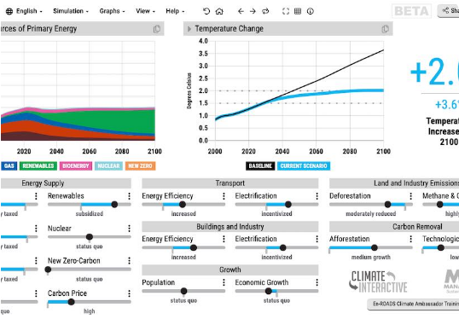
Global CO2 Modeling: MIT En-ROADS
Interactive Climate Mitigation Analysis
■
Systemic Policy Simulation: Tested mitigation paths in the En-ROADS global simulator, proving technology alone cannot halt temperature rises.
■
Multilateral Synergies: Reaching a sub-2°C warming path requires carbon pricing, energy efficiency, and direct fossil disincentives working in tandem.
■
Academic Insight: Outlines the foundational basis of SDG 17—global partnerships are mandatory to deploy technology equitably.

Slide 4
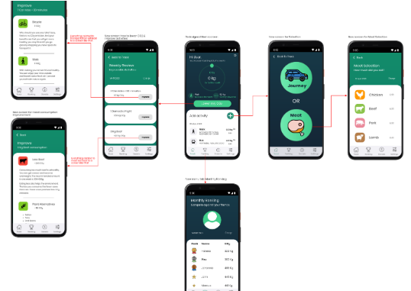
Ecotransit & Footprint Calculators
Tracking Supply-Chain Ecological Costs
■
Multi-modal Freight Diagnostics: Used EcoTransit World calculators to compare air cargo carbon outputs against electrified rail paths.
■
Personal Carbon Audits: Evaluated domestic operational metrics showing how direct consumer food, energy, and travel behaviors compose global demand.
■
Data Integration: Formulates baseline carbon indices, crucial for training smart, predictive carbon optimization models.

Slide 5
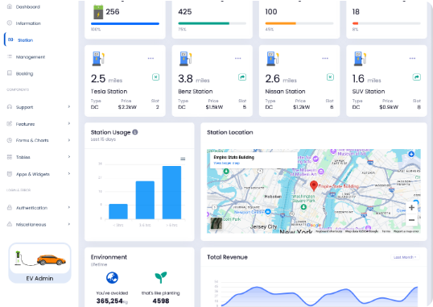
National Action: NITI Aayog E-Amrit
India EV Transition Calculator Analytics
■
Tailpipe vs. Lifecycle Evaluation: Explored the government's official e-AMRIT portal to assess EV grid emission trade-offs.
■
Regional Savings Model: Swapping standard internal combustion vehicles with electric fleets results in up to 45% lower greenhouse emissions.
■
Grid Integration Challenge: Emphasizes the crucial requirement for intelligent smart grid load balancing (EcoGrid-AI proposal).

Slide 6
02 / Environmental Diagnostics
Evaluating resource demands across server hubs and regional vocational frameworks.

Slide 7


The Dark Side of AI Data Centers
2 TWh / year
43% Clustered
Intense Grid Strain
Severe Arid Water Stress
Investigations reveal single massive server hubs consume enough electricity to power 200,000 homes. This immense load has forced local utility providers in Nebraska to postpone coal plant decommissioning to meet the demand spike.
Over 40% of standard high-performance data centers reside in highly water-stressed regions. Evaporative cooling towers require millions of gallons of potable drinking water daily to safeguard processing units from overheating.

Slide 8






Green Skilling & Vocational Frameworks
Sustainability
SCGJ Integration
Eco-Skills
Ensuring present industrial resource utilization patterns do not disrupt future ecological lifecycles, establishing safe biological baselines.
Promoting educational alignment with India's Skill Council for Green Jobs (SCGJ), solar Suryamitra initiatives, and circular economies.
Cultivating technical competencies in environmental data analytics, micro-grid management, and automated smart recycling infrastructure.

Slide 9
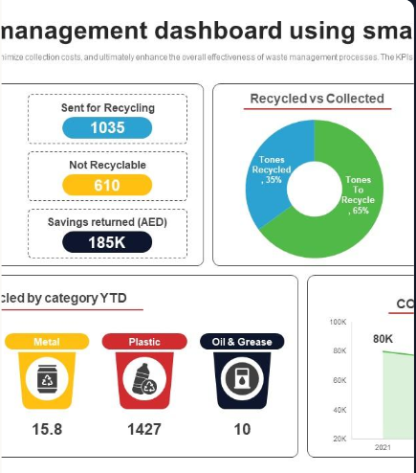
Smart Circular Economies: NANDO
Automated E-Waste Segregation
Computer-vision systems (deployed globally by platforms like NANDO across 17 countries) leverage smart bins with real-time classification models to identify and sort toxic electronic waste materials.
This automated processing protects human sorting operators from exposure, prevents heavy metal soil leaching, and secures rare earth element extraction.

Slide 10
03 / Proposed Capstone Frameworks
Targeted software implementations applying computer engineering to resource optimization goals.

Slide 11
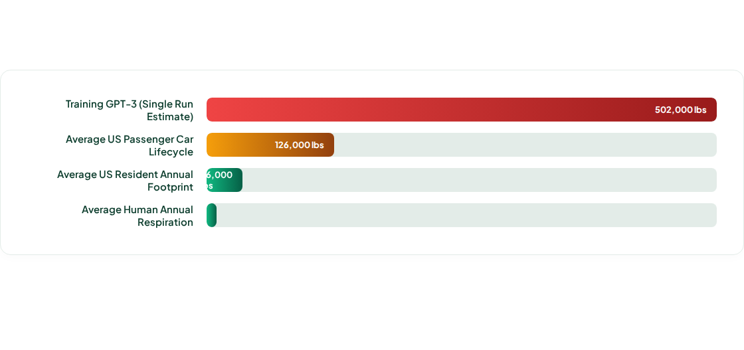
The Cost of Progress: Lifecycle Carbon
Source: Consolidated academic research comparing training runs with consumer indicators. Emphasizes the need for regional smart grids and clean computational routing.

Slide 12


Proposed AI Capstone Project
Project : VisionBin:Automated E-Waste & Circular Economy Classification Engine
Project Objectives
Automated E-Waste Sorting: Build an AI vision pipeline to identify and sort high-value recyclables (PCBs, Metals) from hazardous materials (Batteries) in real-time.
Minimize Computing Footprint: Optimize the Python inference code to run efficiently, directly lowering edge-computing power and data center carbon emissions.
Real-Time Impact Tracking: Embed mathematical models to calculate and display operational Energy ($kWh$), Carbon (kg $CO_2$), and Water usage during automated sorting.
Support Green Skilling (SCGJ): Create an intuitive dashboard interface that allows manual recycling laborers to upgrade their skills and manage automated systems safely.
Enable Global Partnerships (SDG 17): Standardize waste-tracking data logs so municipal corporations and tech manufacturers can collaboratively trace recycling loops.

Slide 13
Empowering SDG 17
Developing software solutions with technical responsibility to safeguard our environmental future.
Presenter: Patel Sani I. | RNG Patel Institute of Technology

